Slide 1
Input Device: Mouse

Slide 2
Computer Mouse
In computing, a mouse (plural mice or mouses) functions as a pointing device by detecting two-dimensional motion relative to its supporting surface. Physically, a mouse consists of a small case, held under one of the user's hands, with one or more buttons. It sometimes features other elements, such as "wheels", which allow the user to perform various system-dependent operations, or extra buttons or features can add more control or dimensional input. The mouse's motion typically translates into the motion of a pointer on a display.

Slide 3
Evolution of Mouse
Many people seem to be curious how the mouse got its name. In the early 1960’s, Douglas Engelbart was fascinated with a theory he called “human augmentation technology,” an idea that the computer should be used to enhance human performance. Up to that time, computers were useful only to military and scientific communities. In 1968, Engelbart made an input device to help people interact with the computer. The original mouse was a small rectangular wooden box with a cable running to the computer. Since the cord looked like a tail and mice are known for scurrying along a surface, this new device quickly became known as a mouse. The mouse turned out to be one of Englebart’s most ingenious ideas. The mouse that we use today has changed little since 1968.

Slide 4
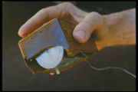
Evolution of Mouse (continued)
Fig: The first computer mouse, held by inventor Douglas Engelbart, showing the wheels that make contact with the working surface

Slide 5
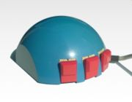
Evolution of Mouse (continued)
Fig: A Smaky mouse, as invented at the EPFL by Jean-Daniel Nicoud and André Guignard.

Slide 6
Evolution of Mouse (continued)
The public first saw a computer mouse when it was attached to the Macintosh computer in 1984. A few years prior to this event, Steve Jobs, co-founder of Apple Computer, was allowed to visit and tour Xerox’s research (PARC) facility in California and noticed this funny-looking thing that was used to move the cursor around the screen of a computer. This was a revolutionary idea, since prior to this the keyboard arrow keys were the only way to navigate a computer screen. Jobs "borrowed" the idea, and designed his own mouse to accompany the unveiling of his new Macintosh to the public. Then Microsoft picked up on it when they released their version of a graphical user interface (Windows) to make things even easier, and the rest, as they say, is history.

Slide 7
How Does a Computer Mouse Work ?
The first types of mice were mostly mechanical, a ball rolled around under the body of the mouse, and rollers sensed the direction and speed at which the mouse was moved.
The rollers were connected to a disc that contained holes and used an IR LED (Light Emitting Diode) to sense the movement.
Two sensors per wheel gave both speed and directional information to an on-board integrated circuit that decoded this data and transmitted it to the computer.
Notes:
IR-Infrared

Slide 8
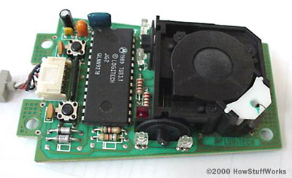
Inside a Mouse
The main goal of any mouse is to translate the motion of your hand into signals that the computer can use. Let's take a look inside a track-ball mouse to see how it works Fig: The guts of a mouse

Slide 9
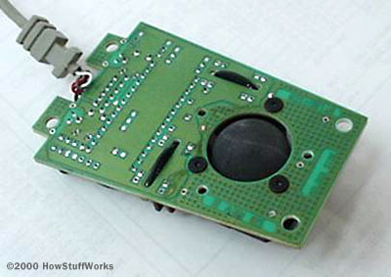
Inside a Mouse (Continued)
1. A ball inside the mouse touches the desktop and rolls when the mouse moves.
Fig: The underside of the mouse's logic board: The exposed portion of the ball touches the desktop.

Slide 10
Inside a Mouse (Continued)
2. Two rollers inside the mouse touch the ball. One of the rollers is oriented so that it detects motion in the X direction, and the other is oriented 90 degrees to the first roller so it detects motion in the Y direction. When the ball rotates, one or both of these rollers rotate as well. The following image shows the two white rollers on this mouse:

Slide 11
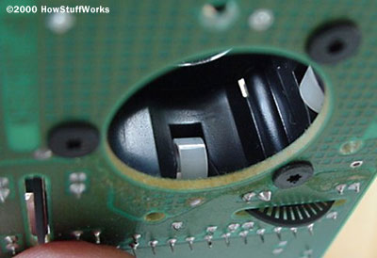
Inside a Mouse (Continued)
Fig: The rollers that touch the ball and detect X and Y motion

Slide 12
Inside a Mouse (Continued)
3.The rollers each connect to a shaft, and the shaft spins a disk with holes in it. When a roller rolls, its shaft and disk spin. The following image shows the disk:

Slide 13
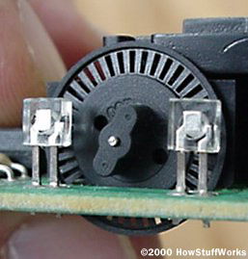
Inside a Mouse (Continued)
Fig: A typical optical encoding disk: This disk has 36 holes around its outer edge.

Slide 14
Inside a Mouse (Continued)
4. On either side of the disk there is an infrared LED and an infrared sensor. The holes in the disk break the beam of light coming from the LED so that the infrared sensor sees pulses of light. The rate of the pulsing is directly related to the speed of the mouse and the distance it travels.

Slide 15
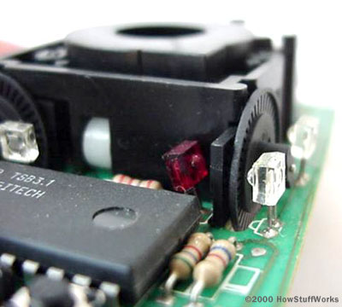
Inside a Mouse (Continued)
Fig: A close-up of one of the optical encoders that track mouse motion: There is an infrared LED (clear) on one side of the disk and an infrared sensor (red) on the other.

Slide 16
Inside a Mouse (Continued)
5. An on-board processor chip reads the pulses from the infrared sensors and turns them into binary data that the computer can understand. The chip sends the binary data to the computer through the mouse's cord.

Slide 17
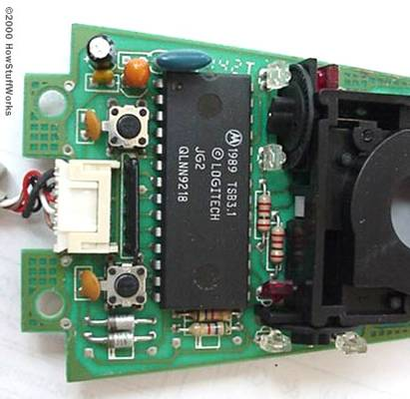
Inside a Mouse (Continued)
Fig: The logic section of a mouse is dominated by an encoder chip, a small processor that reads the pulses coming from the infrared sensors and turns them into bytes sent to the computer. You can also see the two buttons that detect clicks (on either side of the wire connector).

Slide 18
Inside a Mouse (Continued)
In this optomechanical arrangement, the disk moves mechanically, and an optical system counts pulses of light. On this mouse, the ball is 21 mm in diameter. The roller is 7 mm in diameter. The encoding disk has 36 holes. So if the mouse moves 25.4 mm (1 inch), the encoder chip detects 41 pulses of light.

Slide 19
Inside a Mouse (Continued)
Each encoder disk has two infrared LEDs and two infrared sensors, one on each side of the disk (so there are four LED/sensor pairs inside a mouse). This arrangement allows the processor to detect the disk's direction of rotation. There is a piece of plastic with a small, precisely located hole that sits between the encoder disk and each infrared sensor. It is visible in this photo:

Slide 20
Inside a Mouse (Continued)
Fig: A close-up of one of the optical encoders that track mouse motion: Note the piece of plastic between the infrared sensor (red) and the encoding disk.

Slide 21
Inside a Mouse (Continued)
This piece of plastic provides a window through which the infrared sensor can "see." The window on one side of the disk is located slightly higher than it is on the other -- one-half the height of one of the holes in the encoder disk, to be exact. That difference causes the two infrared sensors to see pulses of light at slightly different times. There are times when one of the sensors will see a pulse of light when the other does not

Slide 22

Inside a Mouse (Continued)
Open up a mouse and inside it you will find two wheels, each one similar to the first drawing. The wheel is usually made of black plastic with rectangular slots punched in it. I have shown only 6 slots at 60° spacing but they are a lot closer and many more. Shining through the slots are two LEDs (light Emitting Diodes) shown by the black dots.

Slide 23
Inside a Mouse (Continued)
Each LED shines on to a light sensitive transistor. The two emitters are spaced so that, when one transistor can 'see' its LED through the centre of its window, the other LED is looking at an edge and is therefore switching on or off. In my illustration the LEDs are spaced at 105° (60° x 1.75). The output voltage from the transistor is processed to switch rapidly from high to low as the LED's light is transmitted or occluded so that the voltage is low when the transistor is lit and high when it is in darkness. In the diagram LED A is fully illuminated and LED B is switching. Note that LED B may be switching from light to dark or from dark to light - this depends on the rotation direction.

Slide 24
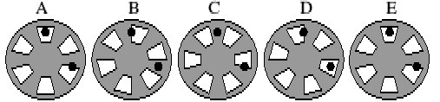
Inside a Mouse (Continued)
Now consider the second drawing

Slide 25
Inside a Mouse (Continued)
Here the wheel is shown in 4 different states, each 15° rotated from the last. Diagram E is equivalent to diagram A, being 60° rotated. For clockwise rotation the states follow each other in order A-B-C-D-E from left to right but if you read the states from right to left, E-D-C-B-A, then these correspond to anticlockwise rotation

Slide 26
Inside a Mouse (Continued)
Notice that LED 2 is changing state from light to dark in diagram A for clockwise rotation and in diagram C for anticlockwise rotation. So if we measure LED1 everytime LED 2 goes from light to dark, if LED 1 is light then we are rotating clockwise but if LED 1 is dark, then we have anticlockwise rotation. The computer uses this fact to monitor direction: each time LED 2 goes from light to dark it samples LED 1 to determine the direction. It uses the number of transitions to measure the distance. In practice the system s a little bit more clever since where are problems if the wheel stops on an edge. Or course the two LEDs are interchangeable and it doesn't matter which one is used as the step and which as the direction. If, in re-wiring you get the two signals interchanged, the mouse will simply work upside down or left to right instead of right to left

Slide 27
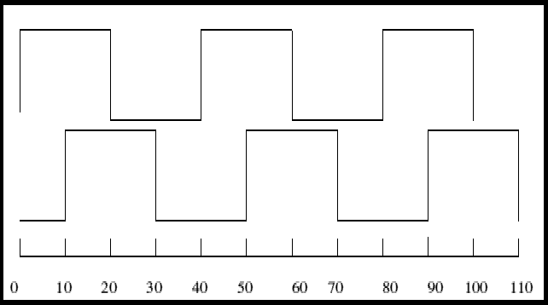
Inside a Mouse (Continued)
The diagram below shows the corresponding electrical signals switching at 15° intervals There are two such wheels, one rotates for vertical movement and the other rotates for horizontal movement of the mouse ball

Slide 28
Varieties of Mice
Mouse come in three basic types:
1. Mechanical,
2. Opto-mechanical and
3. Optical
The basic design is the mechanical mouse with a rubber or plastic ball on its underside that rolls in all direction. The cursor on the screen is moved as the mechanical sensors within the mouse detect the rolling ball’s direction. The opto-mechanical mouse uses optical sensors to detect the motion of the ball. The fully optical mouse uses lasers to detect the mouse's movement. In optical mice, the optical positioning mechanism that is used instead of the ball has a red glow, which gives the mouse a subtle high tech look.

Slide 29
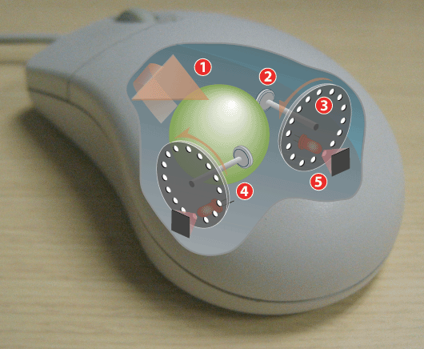
Mechanical Mouse
Fig: Operating a mechanical mouse

Slide 30
Mechanical Mouse
Operating of a Mechanical Mouse:
1: Moving the mouse turns the ball.
2: X and Y rollers grip the ball and transfer movement.
3: Optical encoding disks include light holes.
4: Infrared LEDs shine through the disks.
5: Sensors gather light pulses to convert to X and Y velocities.

Slide 31
Optical Mouse
Developed by Agilent Technologies and introduced to the world in late 1999, the optical mouse actually uses a tiny camera to take thousands of pictures every second.
Able to work on almost any surface without a mouse pad, most optical mice use a small, red light-emitting diode (LED) that bounces light off that surface onto a complimentary metal-oxide semiconductor (CMOS) sensor. In addition to LEDs, a recent innovation are laser-based optical mice that detect more surface details compared to LED technology. This results in the ability to use a laser-based optical mouse on even more surfaces than an LED mouse.

Slide 32
Optical Mouse (Continued)
Here's how the sensor and other parts of an optical mouse work together:
The CMOS sensor sends each image to a digital signal processor (DSP) for analysis.
The DSP detects patterns in the images and examines how the patterns have moved since the previous image.
Based on the change in patterns over a sequence of images, the DSP determines how far the mouse has moved and sends the corresponding coordinates to the computer.
The computer cursor moves the cursor on the screen based on the coordinates received from the mouse. This happens hundreds of times each second, making the cursor appear to move very smoothly.

Slide 33
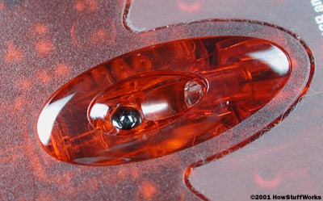
Optical Mouse (Continued)
In this photo, you can see the sensor on the bottom of the mouse.

Slide 34
Accuracy of Optical Mouse
A number of factors affect the accuracy of an optical mouse. One of the most important aspects is resolution. The resolution is the number of pixels per inch that the optical sensor and focusing lens "see" when you move the mouse. Resolution is expressed as dots per inch (dpi). The higher the resolution, the more sensitive the mouse is and the less you need to move it to obtain a response.

Slide 35
Accuracy of Optical Mouse (Continued)
Most mouse have a resolution of 400 or 800 dpi. However, mice designed for playing electronic games can offer as much as 1600 dpi resolution. Some gaming mice also allow you to decrease the dpi on the fly to make the mouse less sensitive in situations when you need to make smaller, slower movements.

Slide 36
Accuracy of Optical Mouse (Continued)
Other factors that affect quality include :
Size of the optical sensor -- larger is generally better, assuming the other mouse components can handle the larger size. Sizes range from 16 x 16 pixels to 30 x 30 pixels.
Refresh rate -- it is how often the sensor samples images as you move the mouse. Faster is generally better, assuming the other mouse components can process them. Rates range from 1500 to 6000 samples per second.
Image processing rate -- is a combination of the size of the optical sensor and the refresh rate. Again, faster is better and rates range from 0.486 to 5.8 mega pixels per second.
Maximum speed -- is the maximum speed that you can move the mouse and obtain accurate tracking. Faster is better and rates range from 16 to 40 inches per second.
Notes:
The process of digitizing the co-ordinate values is called Sampling

Slide 37
Speed of Mouse
The computer-industry often measures mouse sensitivity in terms of counts per inch (CPI), commonly expressed less correctly as dots per inch (DPI) — the number of steps the mouse will report when it moves one inch. In early mice, this specification was called pulses per inch (ppi ). If the default mouse-tracking condition involves moving the pointer by one screen-pixel or dot on-screen per reported step, then the CPI does equate to DPI: dots of pointer motion per inch of mouse motion. The CPI or DPI as reported by manufacturers depends on how they make the mouse; the higher the CPI, the faster the pointer moves with mouse movement.

Slide 38
Speed of Mouse(Continued)
However, software can adjust the mouse sensitivity, making the cursor move faster or slower than its DPI. Current software can change the speed of the pointer dynamically, taking into account the mouse's absolute speed and the movement from the last stop-point. Different software may name the settings "acceleration" or "speed" — referring respectively to "threshold" and "pointer precision". For simple software, when the mouse starts to move, the software will count the number of "counts" received from the mouse and will move the pointer across the screen by that number of pixels (or multiplied by a factor f1=1,2,3). So, the pointer will move slowly on the screen, having a good precision. When the movement of the mouse reaches the value set for "threshold", the software will start to move the pointer more quickly; thus for each number n of counts received from the mouse, the pointer may move (f2 x n) pixels, where f2=2,3...10. Usually, the user can set the value of f2 by changing the "acceleration" setting

Slide 39
Laser Mouse
This mouse uses a small infrared laser instead of an LED, which increases the resolution of the image taken by the mouse laser shines light onto the surface and some of the reflected light bounces directly back into the laser, optically mixing with the light being emitted and partially cancelling-out the light. The movement of the surface changes the frequency of the reflected light in a phenomenon called a Doppler Shift. The difference between the frequency of the emitted light and the reflected light changes how-much the light cancels, and this power level is sensed at the emitter by a photo diode sensor. This power fluctuation corresponds to how fast the surface is moving in-line with the sensor. The direction of movement (away from or toward the laser) is sensed by varying the frequency of the laser, and using two orthogonally-placed lasers senses the movement X and Y dimensions (and apparently using the info from both at once can even sense Z-axis movement too)

Slide 40
Optical versus Mechanical mice
Optical mice have several benefits over track-ball mice:
No moving parts means less wear and a lower chance of failure.
There's no way for dirt to get inside the mouse and interfere with the tracking sensors.
Increased tracking resolution means a smoother response.
They don't require a special surface, such as a mouse pad.

Slide 41
Optical versus Mechanical mice
Drawbacks of Optical Mouse:
Optical Mouse generally cannot track on glossy and transparent surfaces, including some mouse-pads, sometimes causing the cursor to drift unpredictably during operation.
Mechanical mice have lower average power demands than their optical counterparts. This typically has no practical impact for users of cabled mice (except possibly those used with battery-powered computers, such as notebook models), but has an impact on battery-powered wireless models.

Slide 42
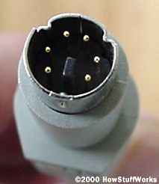
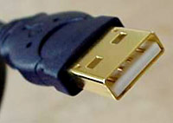
Data Interface
Most mice on the market today use a USB connector to attach to your computer. USB is a standard way to connect all kinds of peripherals to your computer, including printers, digital cameras, keyboards and mice. Some older mice, many of which are still in use today, have a PS/2 type connector

Slide 43
Wireless Mice
Cordless or Wireless mouse no longer has to be physically connected to the computer. Two different technologies are used. Some mice operate by an infrared-port, where the mouse must have a clear line of sight to the computer, much like a television remote control. Other mice use radio frequencies for their wireless technology, which allow the mice to roam farther from the computer. Most wireless mice use radio frequency (RF) technology to communicate information to your computer.

Slide 44
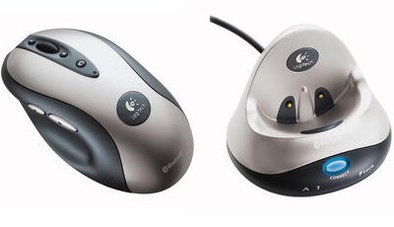
Wireless Mice
Fig: transmitter and receiver of a Wireless Mouse

Slide 45
How Wireless Mouse Works?
Being radio-based, RF devices require two main components: a transmitter and a receiver. Here's how it works:
The transmitter is housed in the mouse. It sends an electromagnetic (radio) signal that encodes the information about the mouse's movements and the buttons you click.
The receiver, which is connected to your computer, accepts the signal, decodes it and passes it on to the mouse driver software and your computer's operating system.
The receiver can be a separate device that plugs into your computer, a special card that you place in an expansion slot, or a built-in component.

Slide 46
RF Mouse
The other common type of wireless mouse is an RF device that operates at 27 MHz and has a range of about 6 feet (2 meters). More recently, 2.4 GHz RF mice have hit the market with the advantage of a longer range -- about 33 feet (10 meters) and faster transmissions with less interference. Multiple RF mice in one room can result in cross-talk, which means that the receiver inadvertently picks up the transmissions from the wrong mouse. Pairing and multiple channels help to avoid this problem. Typically, the RF receiver plugs into a USB port and does not accept any peripherals other than the mouse (and perhaps a keyboard, if sold with the mouse).
Notes:
RF-Radio Frequency

Slide 47
Bluetooth Mice
One of the RF technologies that wireless mice commonly use is Bluetooth. Bluetooth technology wirelessly connects peripherals such as printers, headsets, keyboards and mouse to Bluetooth-enabled devices such as computers and personal digital assistants (PDAs). Because a Bluetooth receiver can accommodate multiple Bluetooth peripherals at one time, Bluetooth is also known as a personal area network (PAN). Bluetooth devices have a range of about 33 feet (10 meters). Bluetooth operates in the 2.4 GHz range using RF technology. It avoids interference among multiple Bluetooth peripherals through a technique called spread-spectrum frequency hopping

Slide 48
Extra Mice Features
Mouse contain at least one button and sometimes as many as three, which can be programmed for different functions. A popular type of mouse has a wheel between two of the buttons that takes the effort out of scrolling through long documents. This wheel makes general computing and Web browsing much easier. The wheel can be used to scroll up and down a page without using the on-screen scroll bars. The wheel can also be used in conjunction with the CTRL key to instantly increase or decrease the size of the text.

Slide 49
Mouse Innovations
As with many computer-related devices, mice are being combined with other gadgets and technologies to create improved and multipurpose devices. Examples include multi-media mice, combination mice/remote controls, gaming mice, biometric mice, tilting wheel mice and motion-based mice.

Slide 50
Mouse Innovations (Continued)
Multi-Media Mouse and Combination Mouse/Remote:
These types of mice are used with multimedia systems such as the Windows XP Media Center Edition computers. Some combine features of a mouse with additional buttons (such as play, pause, forward, back and volume) for controlling media. Others resemble a television/media player remote control with added features for mouse. Remote controls generally use infrared sensors but some use a combination of infrared and RF technology for greater range.

Slide 51
Mouse Innovations (Continued)
Gaming Mice:
Gaming mice are high-precision, optical mice designed for use with PCs and game controllers. Features may include:
Multiple buttons for added flexibility and functions such as adjusting dpi rates on the fly
Wireless connectivity and an optical sensor
Motion feedback and two-way communication

Slide 52
Mouse Innovations (Continued)
Motion-based Mouse:
Yet another innovation in mouse technology is motion-based control. With this feature, you control the mouse pointer by waving the mouse in the air. The technology patented by one manufacturer, Gyration, incorporates miniature gyroscopes to track the motion of the mouse as you wave it in the air. It uses an electromagnetic transducer and sensors to detect rotation in two axes at the same time. The mouse operates on the principle of the Coriolis Effect, which is the apparent turning of an object that's moving in relation to another rotating object

Slide 53
Biometric Mice
Biometric mice add security to your computer system by permitting only authorized users to control the mouse and access the computer. Protection is accomplished with an integrated fingerprint reader either in the receiver or the mouse. This feature enhances security and adds convenience because you can use your fingerprint rather than passwords for a secure login. To use the biometric feature, a software program that comes with the mouse registers fingerprints and stores information about corresponding authorized users

Slide 54
Tilting Scroll Wheel
A recent innovation in mouse scrolling is a tilting scroll wheel that allows you to scroll onscreen both horizontally (left/right) and vertically (up/down). The ability to scroll both ways is handy when you are viewing wide documents like a Web page or spreadsheet. To navigate both horizontally and vertically, the scroll wheel is positioned on a combination fulcrum and lever.

Slide 55
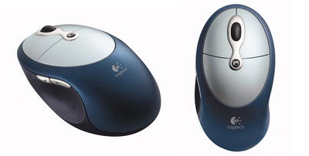
Tilting Scroll Wheel (Continued)
Fig: This is the design used by the Logitech Cordless Click! Plus mouse.

Slide 56
Connectivity and Communication protocols
To transmit their input, typical cabled mice use a thin electrical cord terminating in a standard connector, such as RS-232C, PS/2, ADB or USB. Cordless mice instead transmit data via infrared radiation or radio (including Bluetooth or WiFi), although many such cordless interfaces are themselves connected through the aforementioned wired serial busses.
Notes:
RS-Recommend Standard

Slide 57
Serial interface and protocol
Standard PC mice once used the RS-232C serial standard (released in 1969), via a DB-9 connector. The Mouse Systems Corporation version used a five-byte protocol and supported three buttons. The Microsoft version used an incompatible three-byte protocol and only allowed for two buttons. Due to the incompatibility, some manufacturers sold serial mice with a mode switch: "PC" for MSC mode, "MS" for Microsoft mode.

Slide 58
PS/2 interface and Protocol
With the arrival of the IBM PS/2 personal-computer series in 1987, IBM introduced the eponymous PS/2 interface for mice and keyboards, which other manufacturers rapidly adopted. The most visible change was the use of a round 6-pin mini-DIN, in lieu of the former 5-pin connector. In default mode (called stream mode) a PS/2 mouse communicates motion, and the state of each button, by means of 3-byte packets.

Slide 59
PS/2 interface and Protocol (Continued)
For any motion, button press or button release event, a PS/2 mouse sends, over a bi-directional serial port, a sequence of three bytes, with the following format:
 | D7 | D6 | D5 | D4 | D3 | D2 | D1 | D0
Byte1 | YV | XV | YS | XS | 1 | MB | RB | LB
Byte2 | X Movement
Byte3 | Y Movement

Slide 60
PS/2 interface and Protocol (Continued)
Here, XS and YS represent the sign bits of the movement vectors, XV and YV indicate an overflow in the respective vector component, and LB, MB and RB indicate the status of the left, middle and right mouse buttons (1 = pressed). PS/2 mice also understand several commands for reset and self-test, switching between different operating modes, and changing the resolution of the reported motion vectors.

Slide 61
Alternative pointing devices
Trackball – the user rolls a ball mounted in a fixed base.
Touchpad – detects finger movement about a sensitive surface — the norm for modern laptop computers. At least one physical button normally comes with the touchpad, but users can also (configurably) generate a click by tapping on the pad. Advanced features include detection of finger pressure, and scrolling by moving one's finger along an edge.

Slide 62
Alternative pointing devices (Continued)
Pointing stick – a pressure sensitive nub used like a joystick on laptops, usually found between the g, h, and b keys on the keyboard.
Consumer touchscreen devices exist that resemble monitor shields. Framed around the monitor, they use software-calibration to match screen and cursor positions. Many firms that integrate touchscreen equipment into existing displays and all-in-one devices (such as portables PCs) for a reasonable fee are also in operation.

Slide 63
Alternative pointing devices (Continued)
Camera mouse – a camera tracks a user's head-movement and moves the onscreen cursor. Natural pointers track the dot on a person's head and move the cursor accordingly.
Graphics tablet – a tablet with a pen or stylus used for pointing. The user holds the device like a normal pen and moves it across a special pad. The thumb usually controls the clicking via a two-way button on the top of the pen, or by tapping.
Eyeball-controlled – A mouse controlled by the user's eyeball/retina movements, allowing cursor-manipulation without touch.

